Slide 1
Final Project Presentation
Neil Marks

Slide 2


Snake Using the Logisim Processor
The classic game Snake run in Logisim by the processor I created
Controlled by the A/S/D/W keys to navigate the snake around the area
As the snake eats the apples, it grows in length
If the snake head hits itself or the border, then the game is over

Slide 3
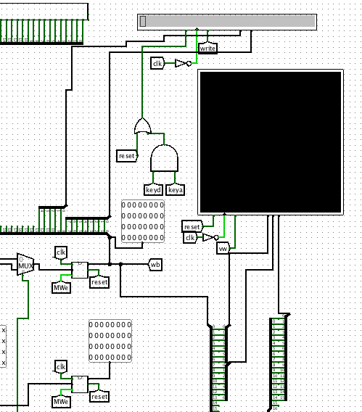
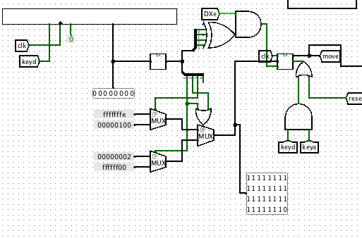
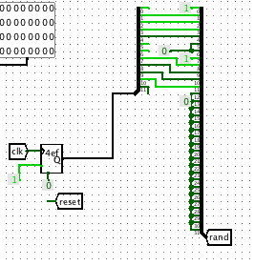
Additions to the Processor
A video LCD display, an LCD character display, a keyboard queue input, and a random odd number generator were added to the processor each with their own instructions

Slide 4
Video and Character LCD Displays
The data from the write back register is used to input to the video and character LCD displays
For the video display, bits 0-6 specify the x location and bits 7-13 specify the y location in the display with the immediate value from the instruction specifying the color
For the character display, bits 0-7 specify the character to be printed with bits 8-12 specifying the location to print the character in the display
Both have their own enable inputs and update on the negative edge of the clock
A double keyboard input instruction will clear the character display but not the video display as this allows for the borders of the game to remain

Slide 5
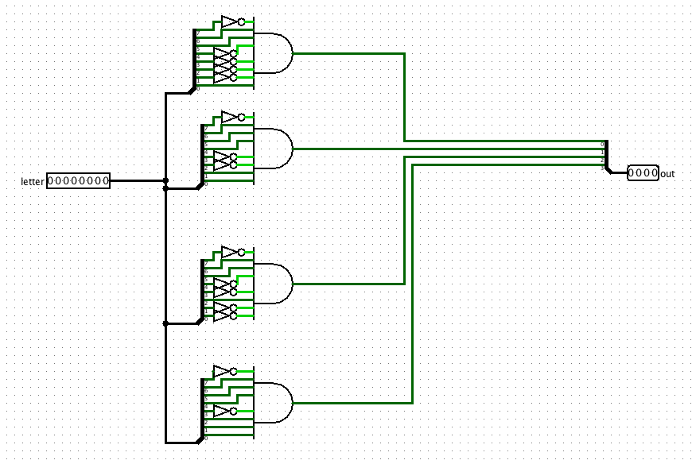
Keyboard Input
The first keyboard entry input between moves is taken with this setup
Every key instruction clears the queue
With a constant 0 on the RE input, then the first input isn’t altered between key instructions
The sub circuit then outputs whether the instruction was an A, S, D, or F and uses a series of muxes to select the corresponding direction of travel
The direction of travel is stored in a latch between the decode and executed stage that is only enabled when the the keyboard input is one of the 4 letter inputs
A double key instruction is used to reset this direction latch to 0 to enable restarting of the game without a preset first movement
The output of this latch is output to the ALU output latch to later be written into the desired register

Slide 6
Random Number Generator
The Logisim random number was used to output a random number used as the location of the new apple
Since the initial upper left corner of the head location was at an odd x and y numbered location at the middle of the board, all randomly generated numbers were fixed to be odd as well since movement was by 2 pixels at a time
The random number is then passed to be stored in the ALU output latch to later be stored into the desired register

Slide 7
Custom Instructions Added
vid $rd, $rs, N
Writes the color specified by the lower 16 bits of N to the video display at the location of $rd + $rs with the lower 7 bits being the x location and bits 7-13 being the y location
key $rd
Writes the decoded direction that is being stored in the direction latch to $rd
write $rd, $rs, N
Writes the character specified by the lower 8 bits of $rs + N to the location specified by bits 8-12 of $rs + N
rand $rd
Writes the randomly generated odd number to $rd

Slide 8
Mips Code Flow Chart
Update Score;
Create New Apple
Apple Here
Initialize Borders
Initialize Snake Head Location and First Apple
Input Move and Check Next Head Location
Move Snake
Nothing here
Border or Snake Here
Game Over;
Remove Snake

Slide 9
Final Product
Accomplishments
Challenges
The game plays completely correct
All output and input devices were correctly incorporated into the processor with their instructions
The timing is constant for almost whatever happens in the game at all points in the game (33 clock cycles per move)
The score is output in decimal form
A successful reset was established by a back to back key instruction
The clock in Logisim never achieved a high enough frequency to allow smooth movement (more like an inchworm instead of a snake)
Using the premade inputs/outputs as the keyboard queue is not ideal (i.e. holding a key puts it in the queue a lot)
The game had to be scaled down to run more efficiently

Slide 10
Demonstration

Slide 11
